Slide 1
Analysis of EPA Fuel Economy
By Josue Guevara

Slide 2

Overview & Problem Statement
How do car size drive fuel economy and annual fuel costs?
Estimated Annual Fuel Cost: based on annual mileage of 15,000 miles and projected gas prices.
Combined fuel economy (Combined MPG): weighted average of City and highway MPG.

Slide 3
Data AnalyZed
Using 38,000 records from years 1984 to 2017
The data used for this includes vehicle types, technical specs for fuel Economy and CO2 emissions.
Found a normal distribution for Combined MPG, Annul Fuel Cost, and Tailpipe CO2 emissions based on the descriptives

Slide 4
Hypothesis
H₁: No significant difference in Annual Fuel Cost or CO2 emissions between Compact and Large cars.
H₂ There is no significant difference in Annual Fuel Cost or CO2 emissions between regular and premium gas.

Slide 5
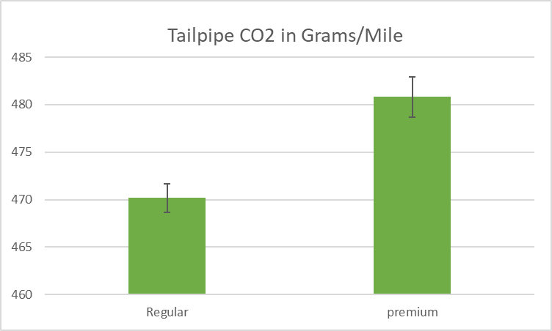
Premium Fuel v. Regular Fuel
There is a statistically significant difference between Premium gas and Regular gas
95% confidence cars using Premium gas release 8g/m and 13g/m more CO2 than Regular gas cars

Slide 6
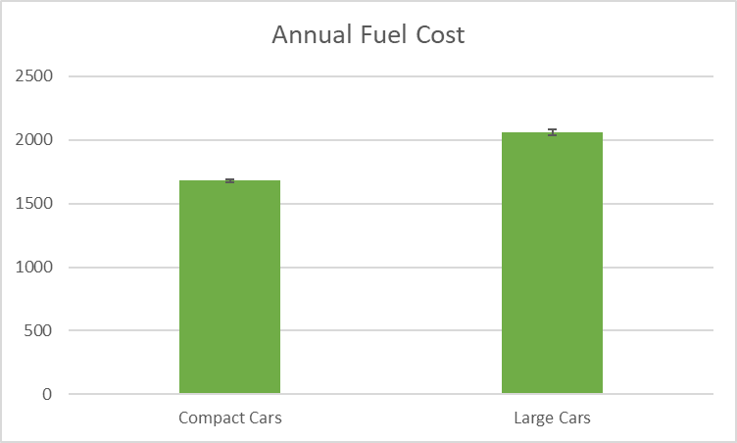
Total Annual Fuel Cost: Compact Cars v. Large Cars
There is a significant difference between Compact Cars and Large Cars
With 95% confidence, a Large car costs between $352 and $405 more than a Compact car annually

Slide 7
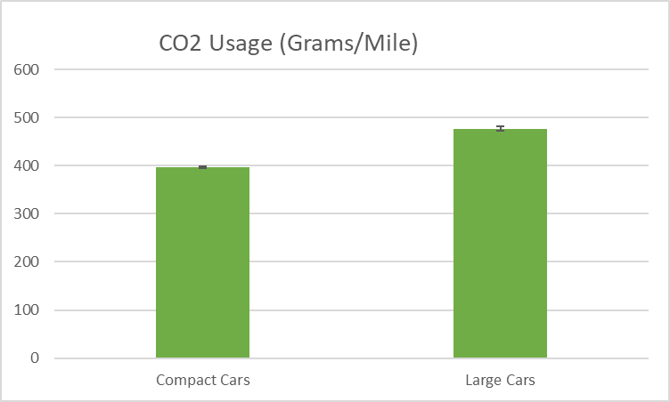
CO2 Emissions: Compact Cars v. Large Cars
There significant difference between Compact Cars and Large Cars
95% confidence cars using Large Cars emit more CO2 than compact cars in a range of 74.3g/m and 85.5gm more

Slide 8
Findings + solutions
CO2 emissions in Large cars is much higher than Compact cars:
Drive Compact Vehicles to reduce CO2 emissions
Drive Compact Vehicles to safe on fuel cost
CO2 emissions could be greater when using premium fuel, regardless of the size of the car:
Drive a car that doesn’t require premium fuel to reduce CO2 emissions long term

Slide 9
Questions!

Slide 10
THANK YOU!

